Slide 1
Introduction to Statistical Methods

Slide 2
Session 3:
Conditional Probability, Independent events and, Total Probability
(10/08/2025)

Slide 3

IMP Note to Self

Slide 4
Important Note for Students
All submissions for graded components must be the result of your original effort.
It is strictly prohibited to copy and paste verbatim from any sources, whether online or from your peers.
The use of unauthorized sources or materials, as well as collusion or unauthorized collaboration to gain an unfair advantage, is also strictly prohibited. Please note that we will not distinguish between the person sharing their resources and the one receiving them for plagiarism, and the consequences will apply to both parties equally.

Slide 5
Important Note for Students
In cases where suspicious circumstances arise, such as identical verbatim answers or a significant overlap of unreasonable similarities in a set of submissions, will be investigated, and severe punishments will be imposed on all those found guilty of plagiarism.

Slide 6
Revise
Counting Principles
Definition of Probability
Axioms of Probability
Introduction to Probability
Review of Set Theory
Addition Rule of Probability

Slide 7
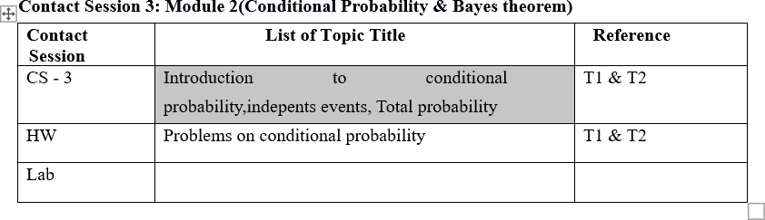
Contact Session 3

Slide 8
Agenda
Conditional Probability
Independent Events
Total Probability

Slide 9
Conditional Probability
The probabilities assigned to various events depend on the experimental situation when the assignment is made.
Subsequent to the initial assignment, partial information relevant to the outcome of the experiment may become available.
Such information may cause us to revise some of our probability assignments.

Slide 10
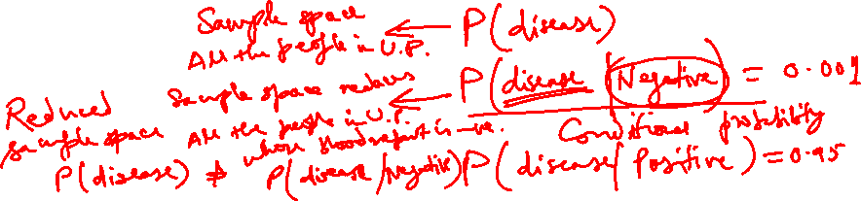
Conditional Probability: Example
We examine how the information “an event A has occurred” affects the probability assigned to B.
For example, B might refer to an individual having a particular disease in the presence of certain symptoms.
If a blood test is performed on the individual and the result is negative, then the probability of having the disease will change (it should decrease, but not usually to zero, since blood tests are not infallible).
We will use the notation to represent the conditional probability of B given that the event A has occurred. A is the “conditioning event.”

Slide 11
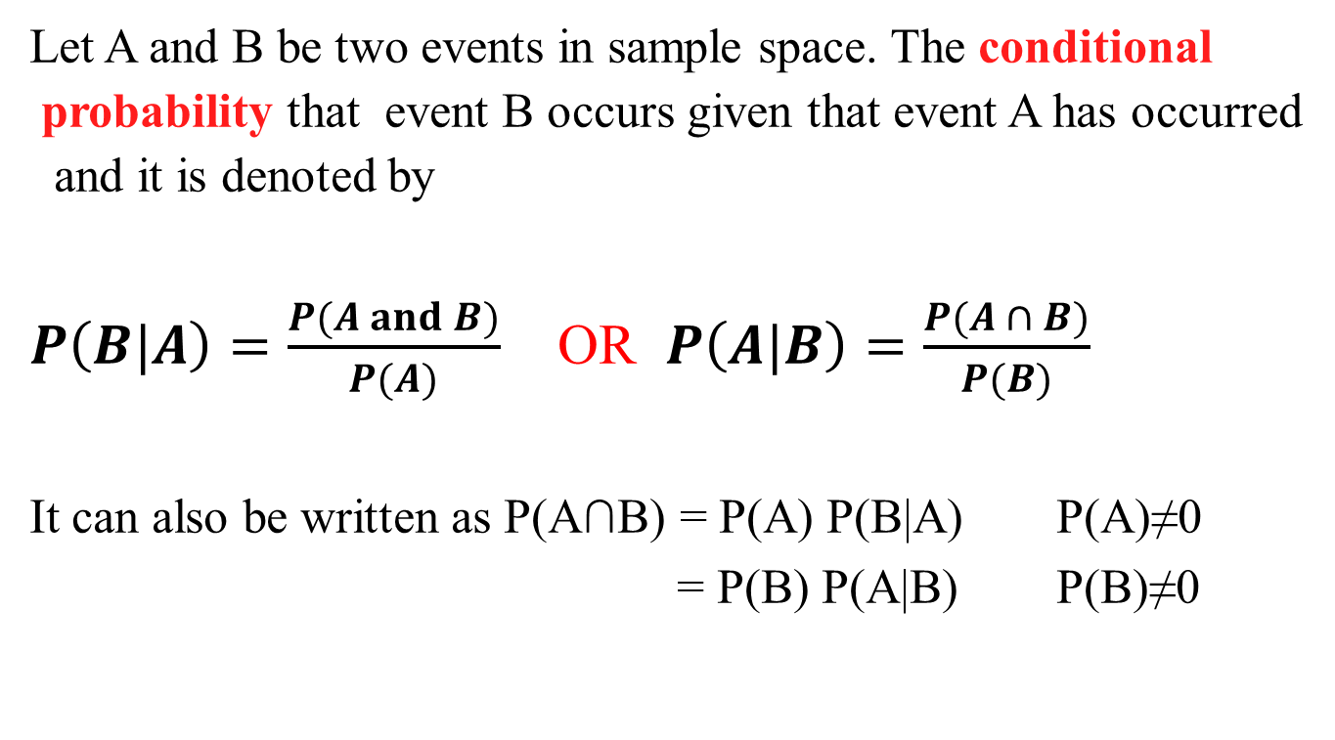
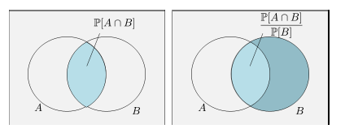
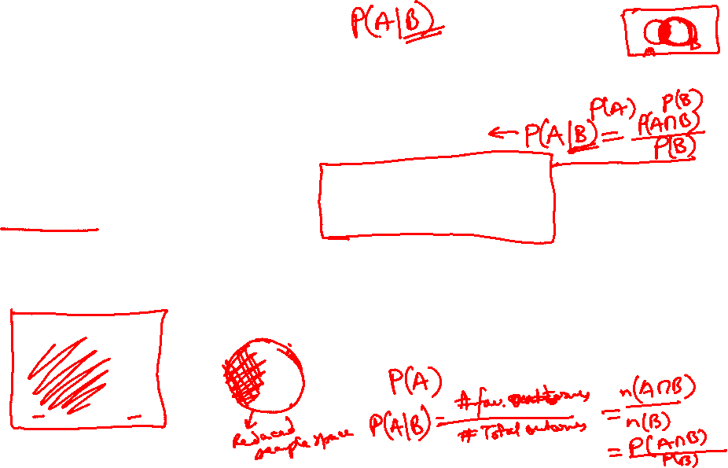
Conditional Probability

Slide 12
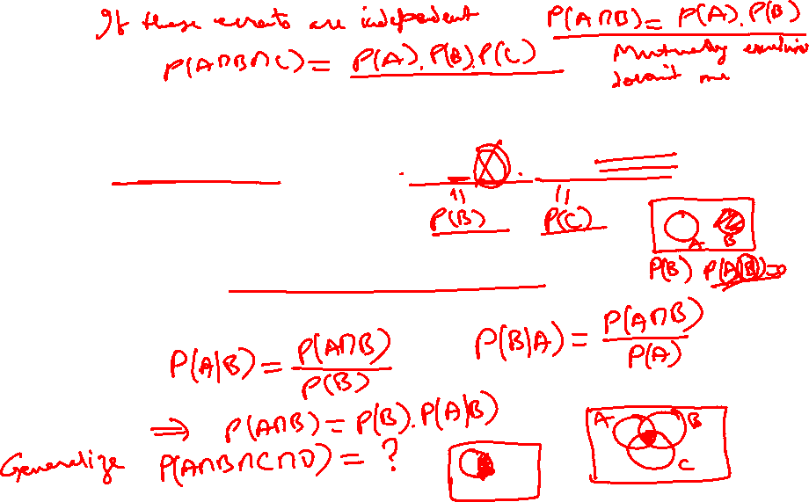
Conditional Probability
Let A,B and C be three events in a sample space S,
then P(A∩B∩C) = P(A) P(B|A) P(C|A∩B)
and it is called Multiplication Rule.

Slide 13
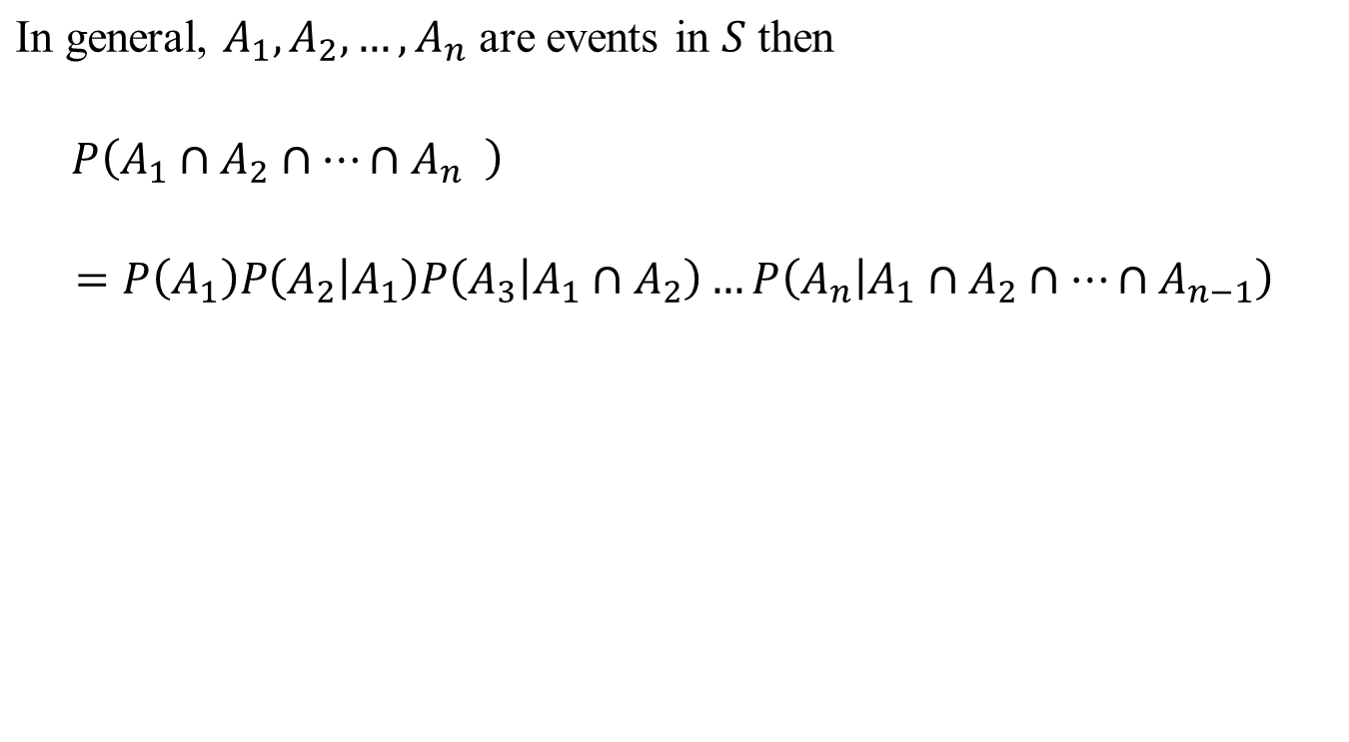
Conditional Probability

Slide 14
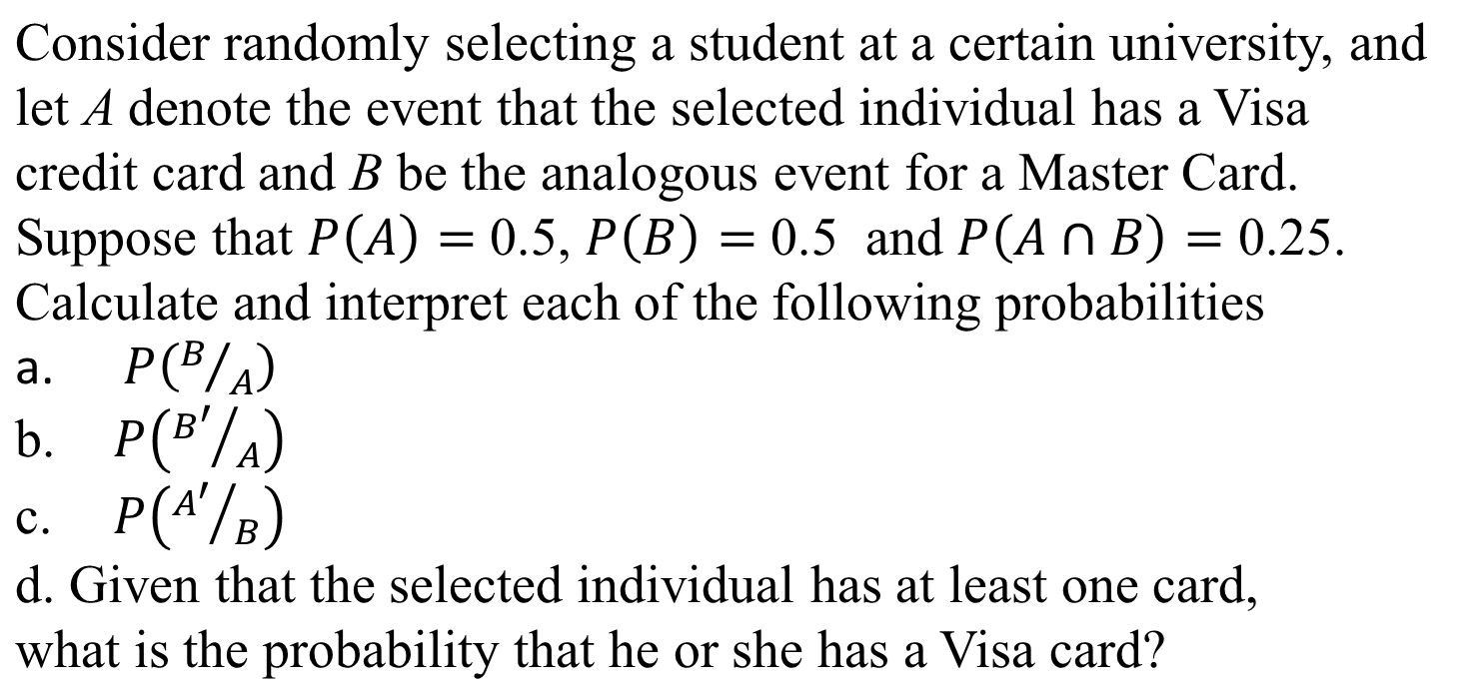

Example: 1

Slide 15
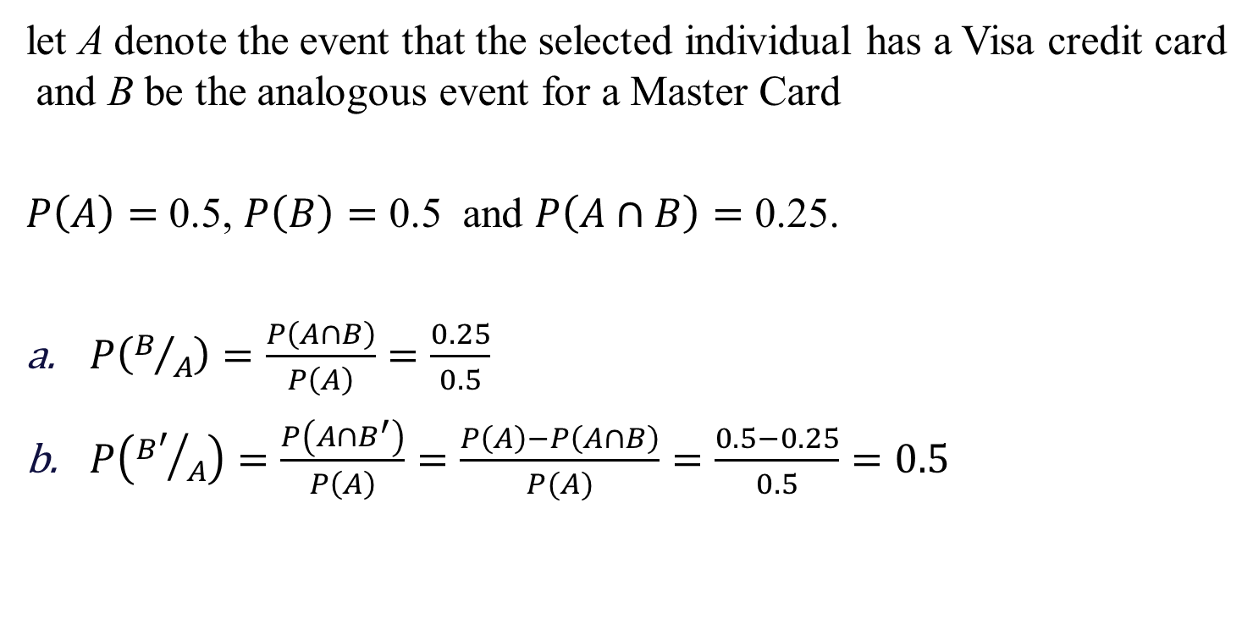
Solution

Slide 16
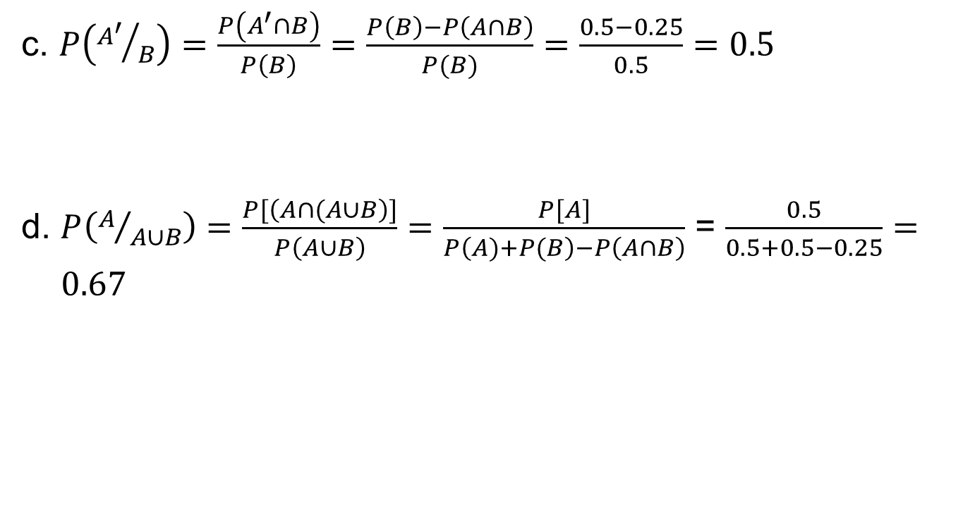
Solution:

Slide 17
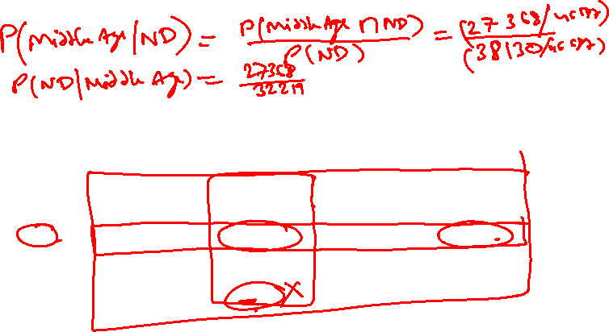
Example-2
Following table contains the different age group people who have defaulted or not defaulted on Loans.
What is the probability that a person will not default on the loan given he/she is middle-aged?
What is the probability that a person is middle-aged given he/she has not defaulted on the loan?
 |  | Age
 |  | Young | Middle-Aged | Senior citizens | Total
Loan Default | No | 10503 | 27368 | 259 | 38130
 | Yes | 3586 | 4851 | 120 | 8557
 | Total | 14089 | 32219 | 379 | 46687

Slide 18
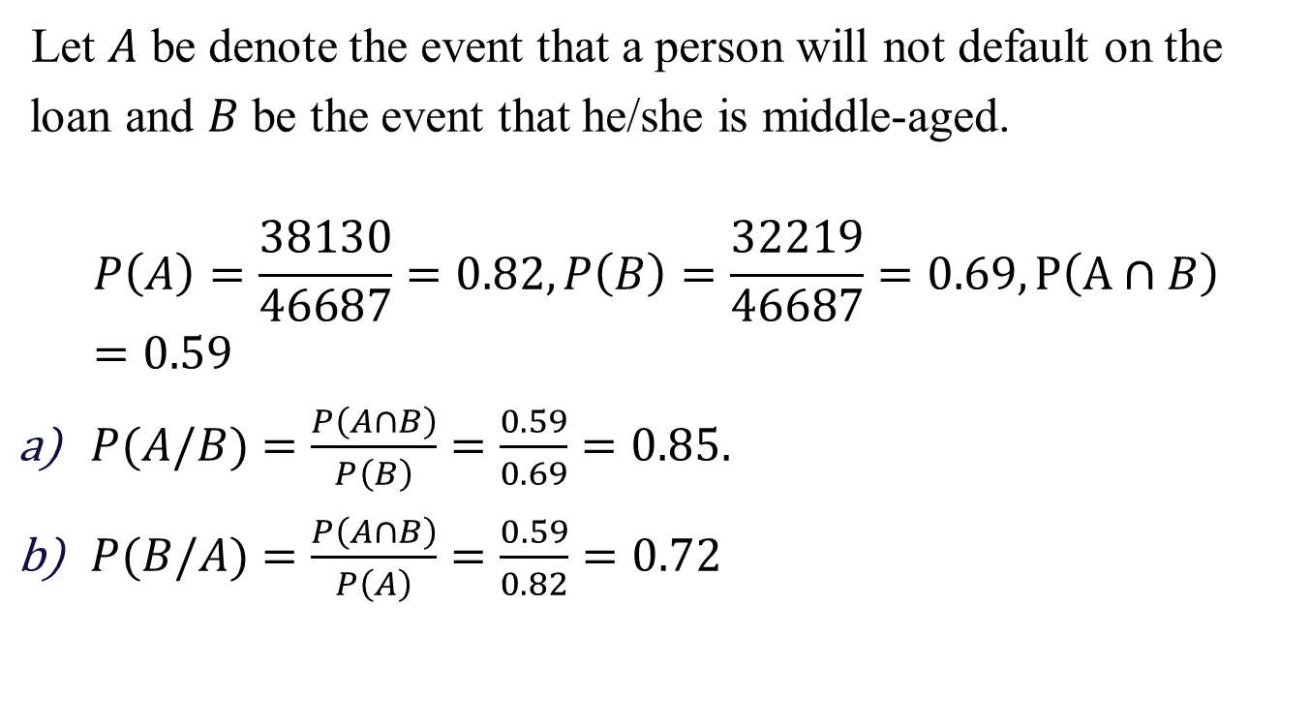
Solution
 |  | Age
 |  | Young | Middle-Aged | Senior citizens | Total
Loan Default | No | 10503 | 27368 | 259 | 38130
 | Yes | 3586 | 4851 | 120 | 8557
 | Total | 14089 | 32219 | 379 | 46687

Slide 19
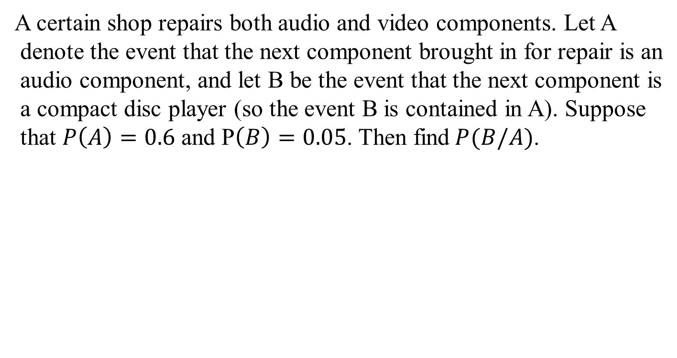
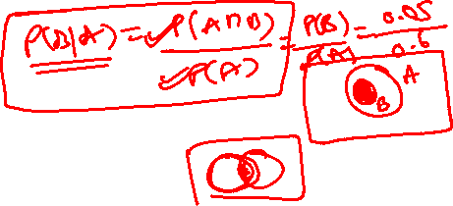
Example-3

Slide 20
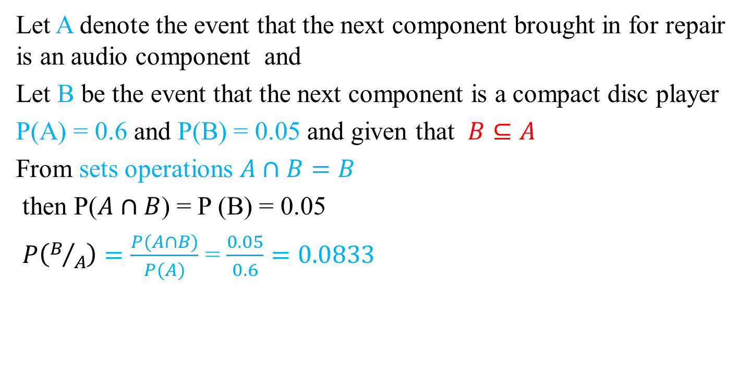
Solution

Slide 21
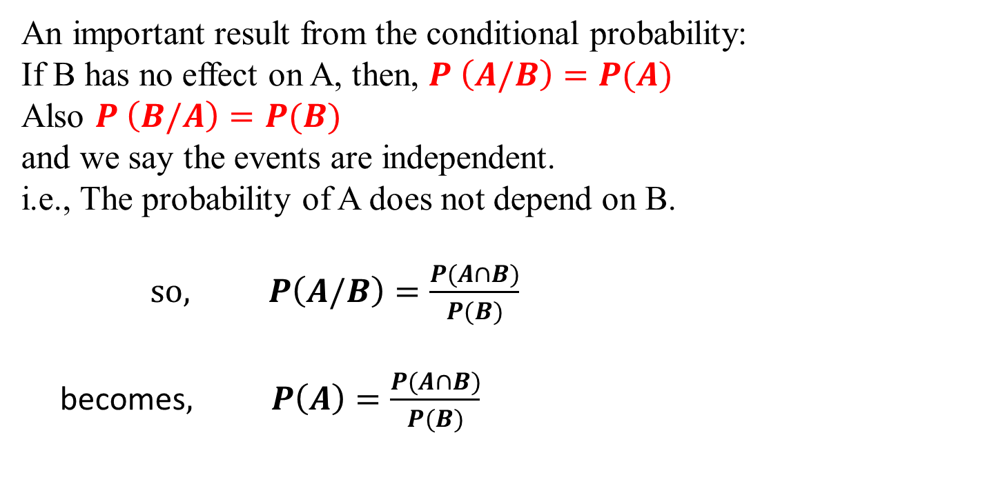

Independent Events
(Statistically Independent)
or P(A ∩ B) = P(A) × P(B)

Slide 22
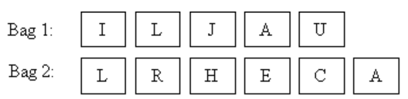
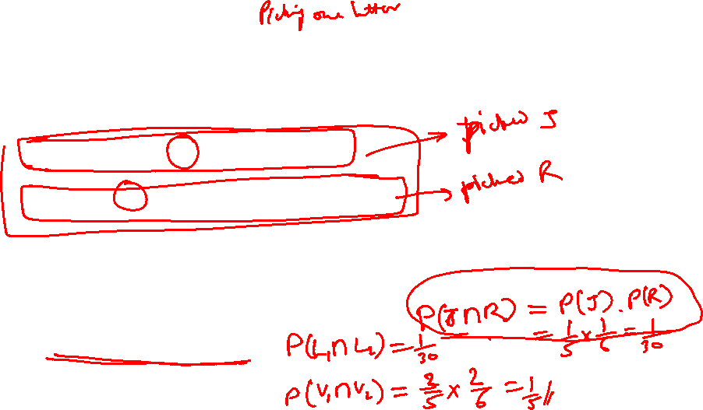
Example-1
Two sets of cards with a letter on each card as follows are
placed into separate bags:
Bala randomly picked one card from each bag. Find the probability
that: a) He picked the letters ‘J’ and ‘R’. b) Both letters are ‘L’. c) Both letters are vowels.

Slide 23
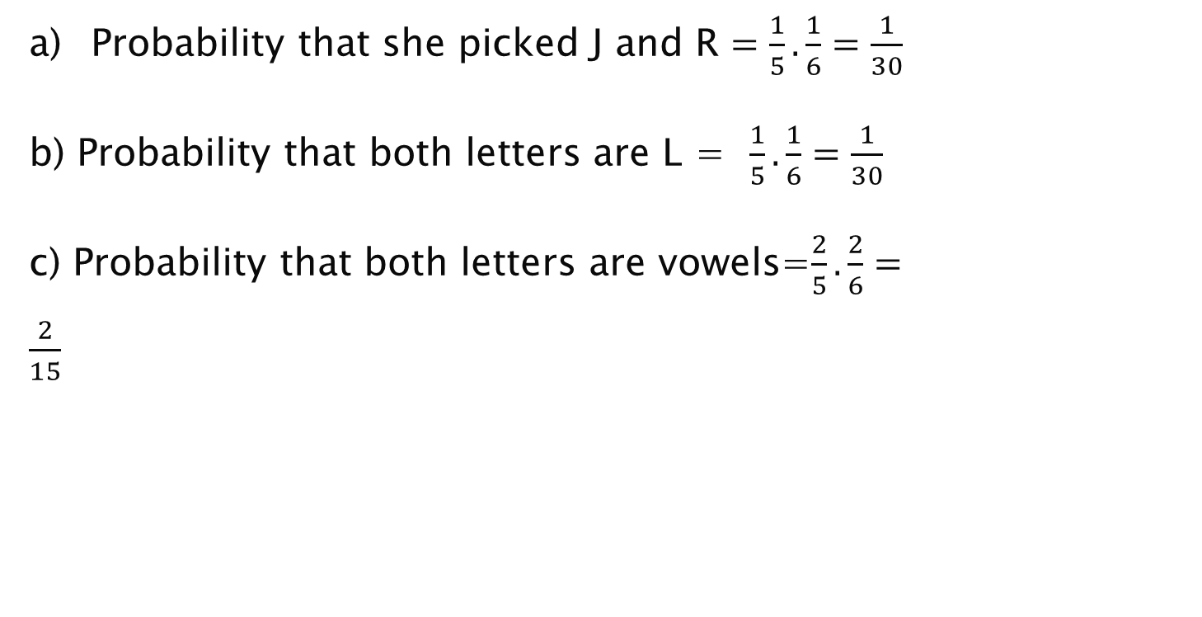

Solution

Slide 24
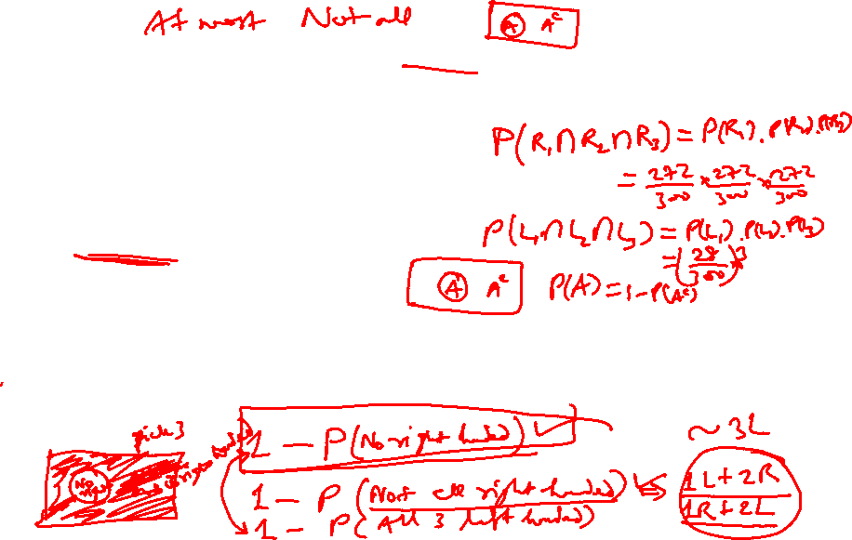
Example-2
In a group of 300 adults, 272 are right-handed, 3 adults are selected with replacement. Find
P(all 3 are right- handed)
P(all 3 left-handed)
P(At least one right-handed)
Solution:
P(one right-handed) = 272/300 =0.907
P(one left-handed) = (300-272)/300 = 28/300 = 0.093

Slide 25
Solution
a) P(3 right-handed) = (272/300) (272/300)(272/300)
= (272/300)³ = 0.745
b) P( 3 left-handed) = (28/300)(28/300)(28/300) = (28/300)³
= 0.0008
c) P(At least one right-handed) = 1 – P(All 3 left-handed)
= 1 - 0.0008
= 0.9992

Slide 26
Example-3
Each day, Monday through Friday, a batch of components sent by a first supplier arrives at a certain inspection facility. Two days a week, a batch also arrives from a second supplier. Eighty percent of all supplier 1’s batches pass inspection, and 90% of supplier 2’s do likewise. What is the probability that, on a randomly selected day, two batches pass inspection? We will answer this assuming that on days when two batches are tested.

Slide 27
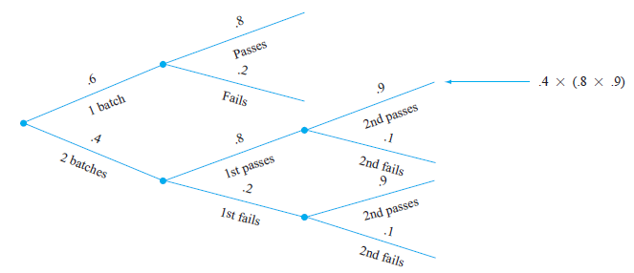
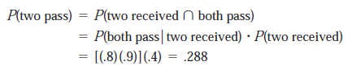
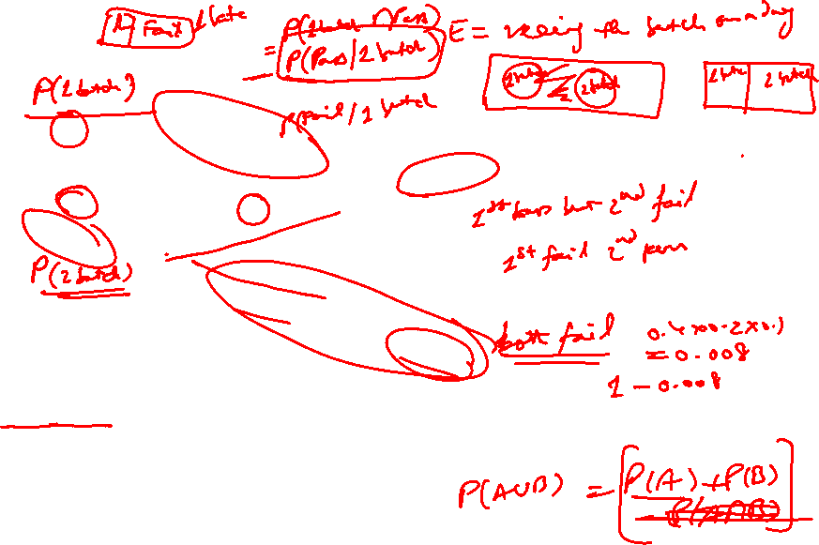
Solution

Slide 28
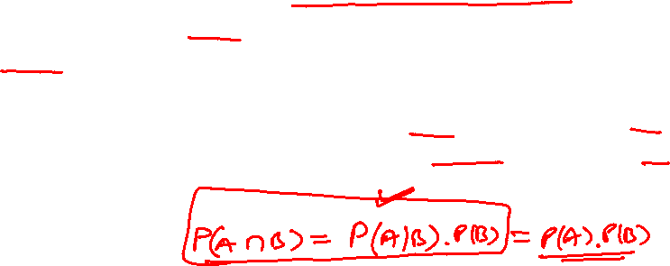
Example-4
A data science team is working on a model to predict whether an
email is spam or not. They are using two independent features:
The presence of the word "offer“ (Feature A) and the presence of
a suspicious link (Feature B).
The probability that an email contains the word "offer“ (Feature A) is 0.6.
The probability that an email contains a suspicious link (Feature B) is 0.4.
What is the probability that an email contains both the word "offer" and a suspicious link?
What is the probability that an email contains either the word "offer" or a suspicious link or both?
What is the probability that an email contains neither the word "offer" nor a suspicious link?

Slide 29
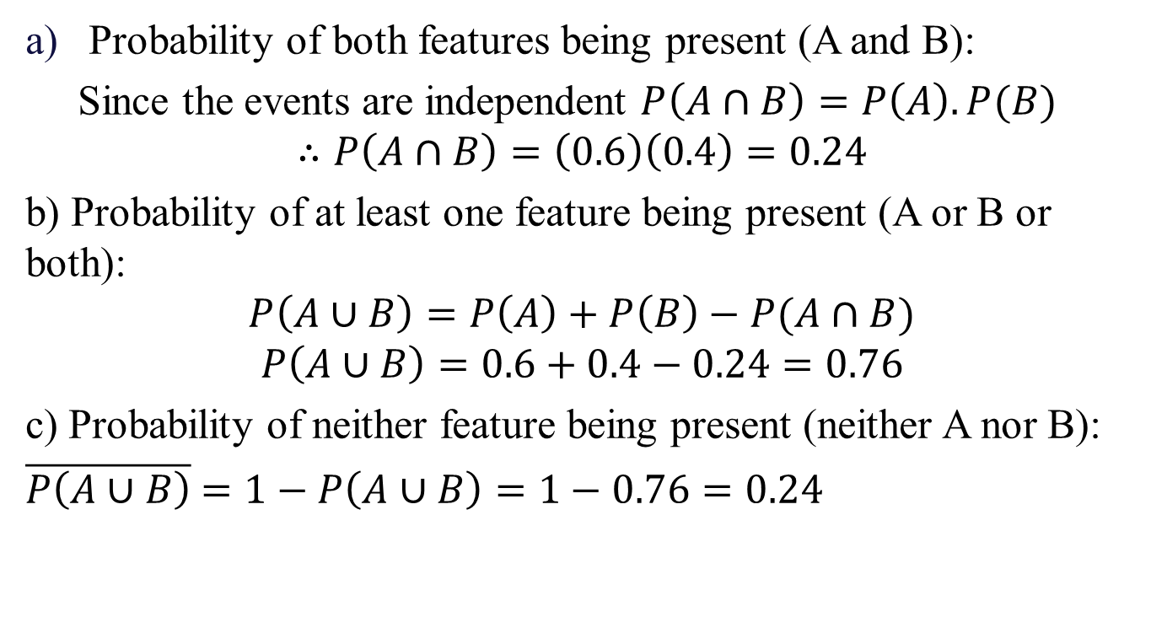
Solution

Slide 30
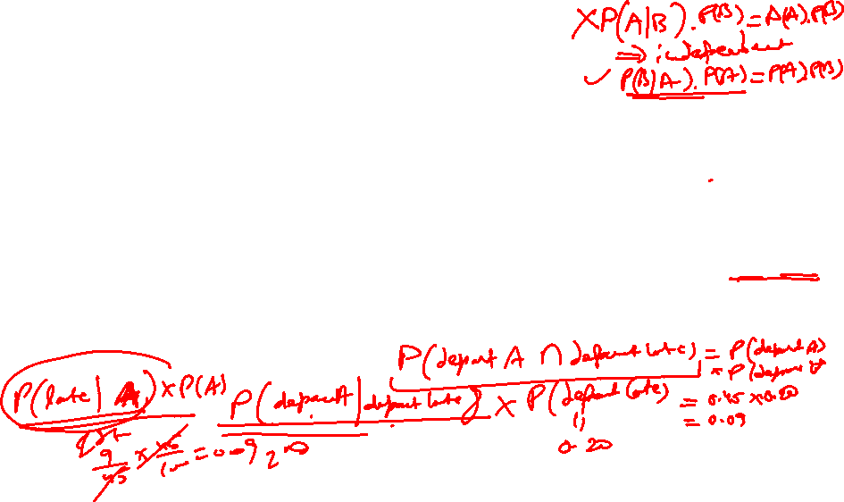
Miscellaneous Examples
1. In a jar with 5 red, 6 blue and 2 white marbles. Two marbles are selected, find the probability that both are red if:
a) If two marbles are selected with replacement.
b) If two marbles are selected without replacement.
2. In batch of 6400 light bulbs, 80 are defective. If 12 light bulbs are selected from the batch without replacements, find probability that all are good.
3. In a city with two airports, 100 flights were surveyed. 20 of those flights departed late. 45 flights in the survey departed from airport A; 9 of those flights departed late. 55 flights in the survey departed from airport B; 11 flights departed late. Are the events "depart from airport A" and "departed late" independent?

Slide 31
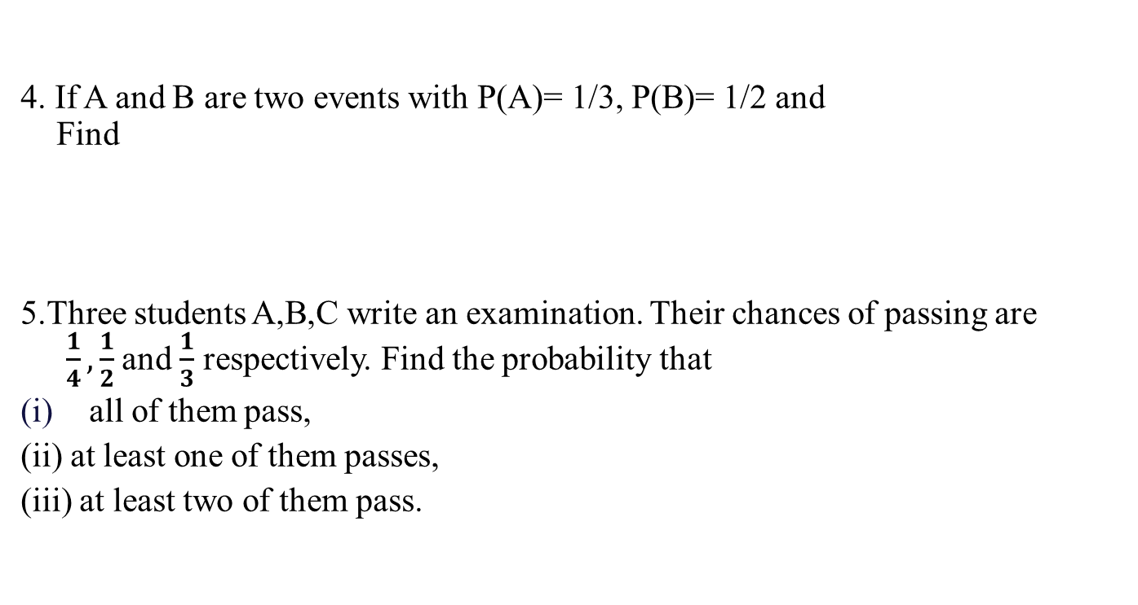
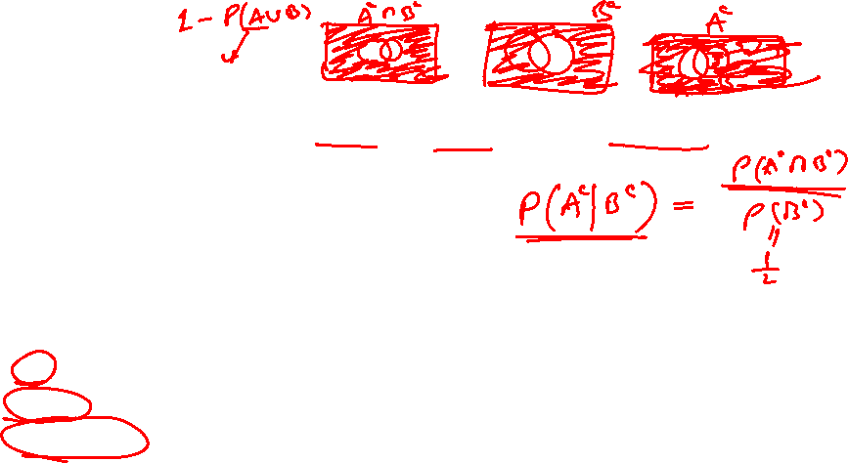
Contd….

Slide 32
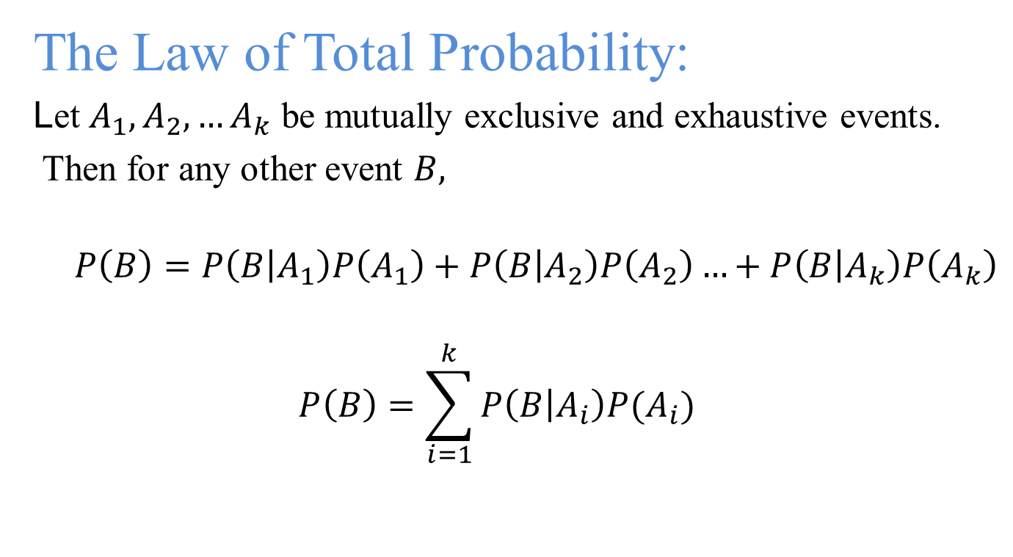

Total Probability

Slide 33








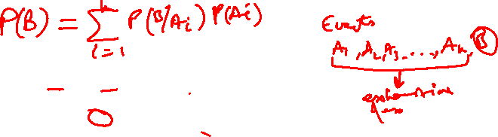
S= A₁ U A₂ U … U A_{k}
and A₁ ∩ A₂ ∩ … ∩ A_{k} =∅
B
𝐴₅
S
𝐴
1
𝐴₃
𝐴₄
𝐴₂
𝐴₆
𝐴_{𝑘}
∴ B = B ∩ S = B ∩{A₁ ∪ A₂ ∪ A₃ , . . . ∪ A_{k} }

Slide 34
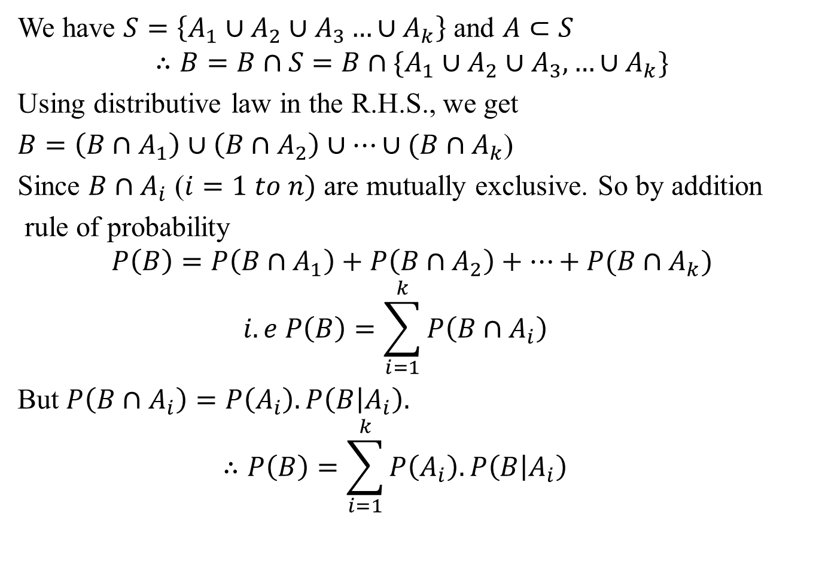
Proof

Slide 35
The theorem of total probability (Tree Diagram)
B
A₁
A₂
A₃
A_{k}

Slide 36
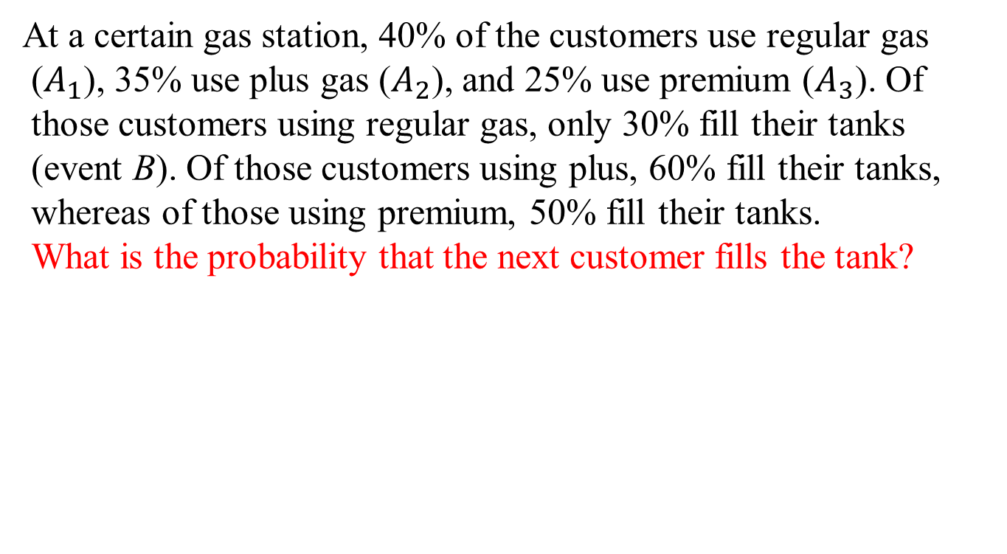
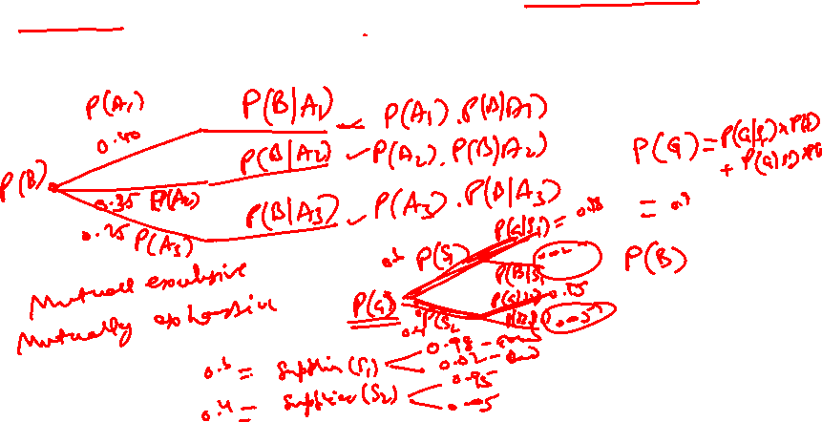
Example-1

Slide 37
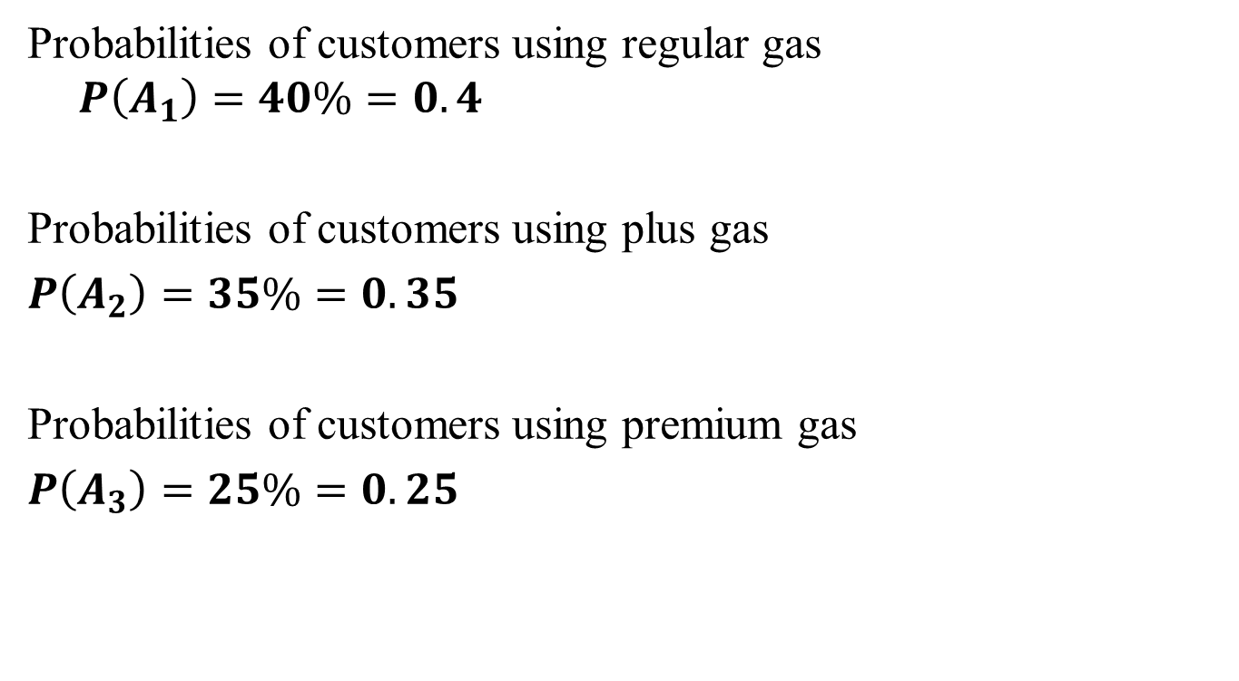
Solution

Slide 38
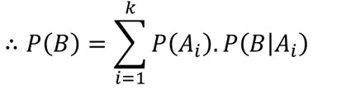
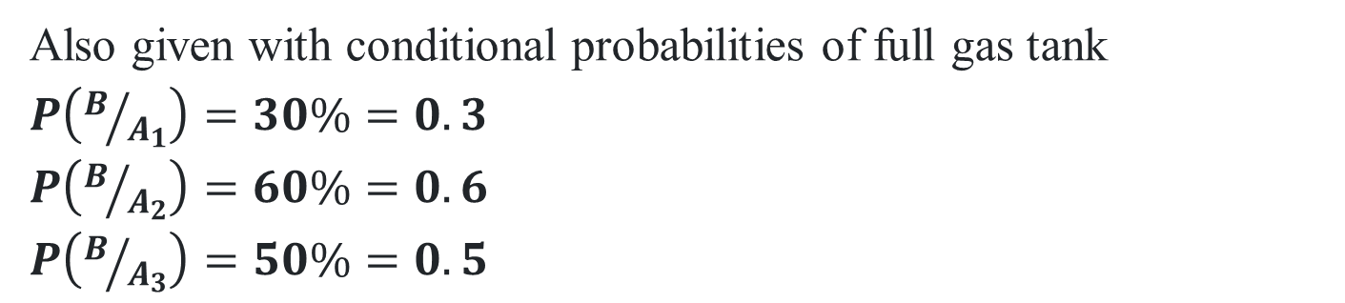
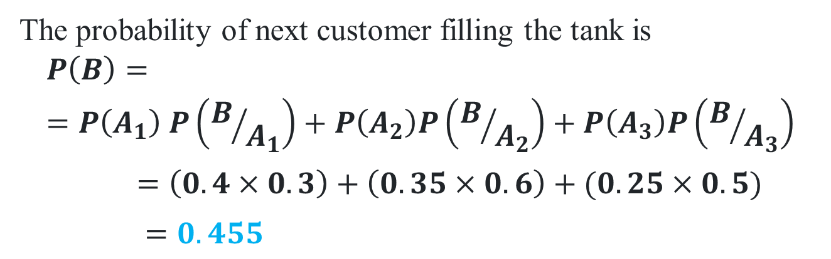

Slide 39
Example-2
A simple binary communication channel carries messages by using only two signals, say 0 and 1. For a given binary channel, 40% of the time a 1 is transmitted; the probability that a transmitted 0 is correctly received is 0.90, and the probability that a transmitted 1 is correctly received is 0.95. Determine
The probability of a 1 being received, and
Given a 1 is received, the probability that 1 was transmitted.

Slide 40
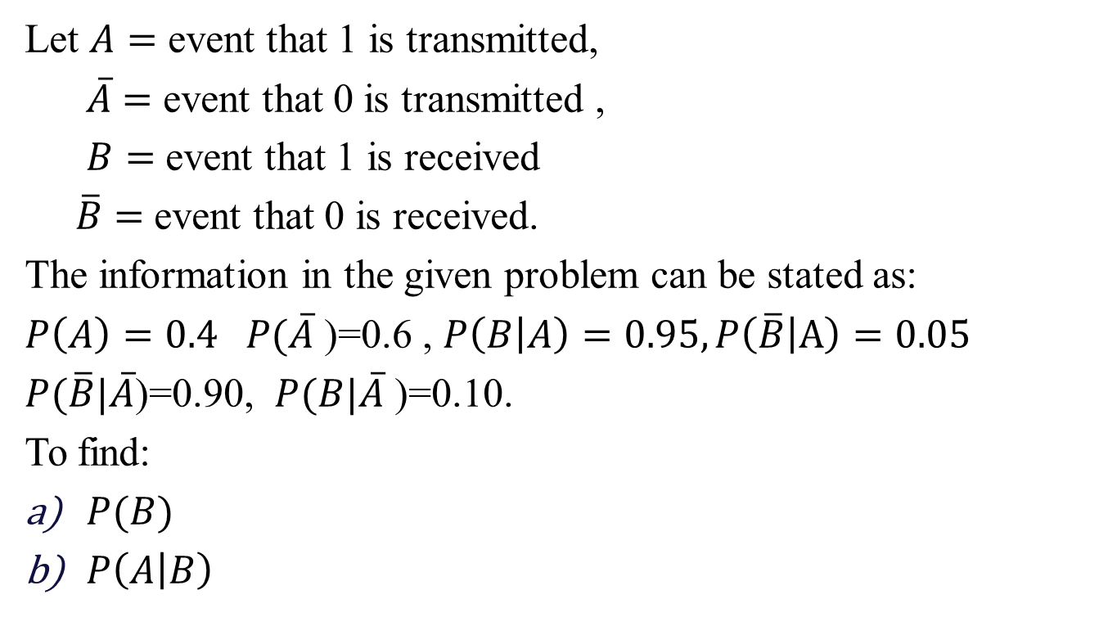
Solution

Slide 41
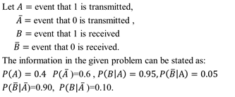
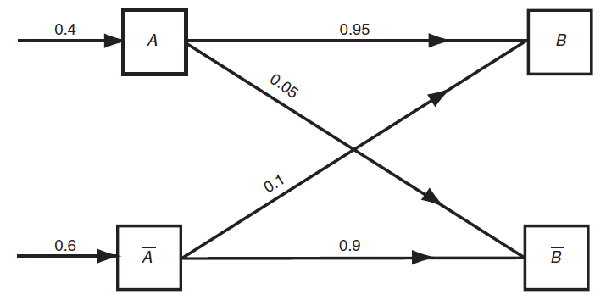
Solution
Probabilities associated with a binary channel

Slide 42
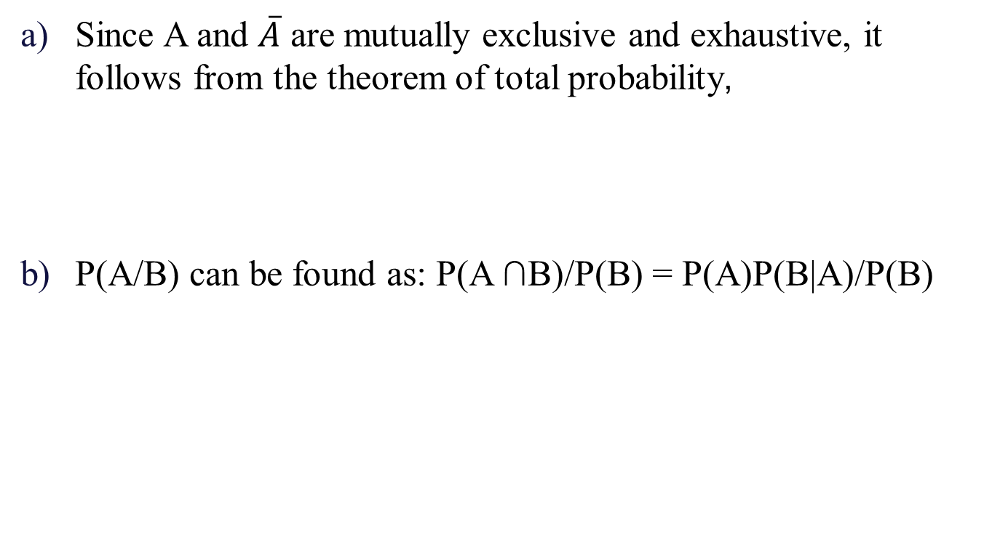
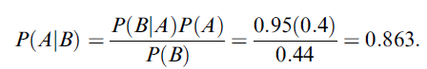

Slide 43
Example-3
A data science team is developing a predictive model to determine whether a user will click on an online advertisement. The likelihood of a user clicking on an ad depends on the type of device they are using. The team has categorized the devices into three types: desktop, tablet, and mobile.
The probabilities of a user using each type of device are as follows:
The probability that a user uses a desktop is 0.5.
The probability that a user uses a tablet is 0.2.
The probability that a user uses a mobile device is 0.3. Also,
The probability of clicking on an ad given that the user is on a desktop is 0.04.
The probability of clicking on an ad given that the user is on a tablet is 0.06.
The probability of clicking on an ad given that the user is on a mobile device is 0.1.
What is the overall probability that a user will click on an ad?

Slide 44
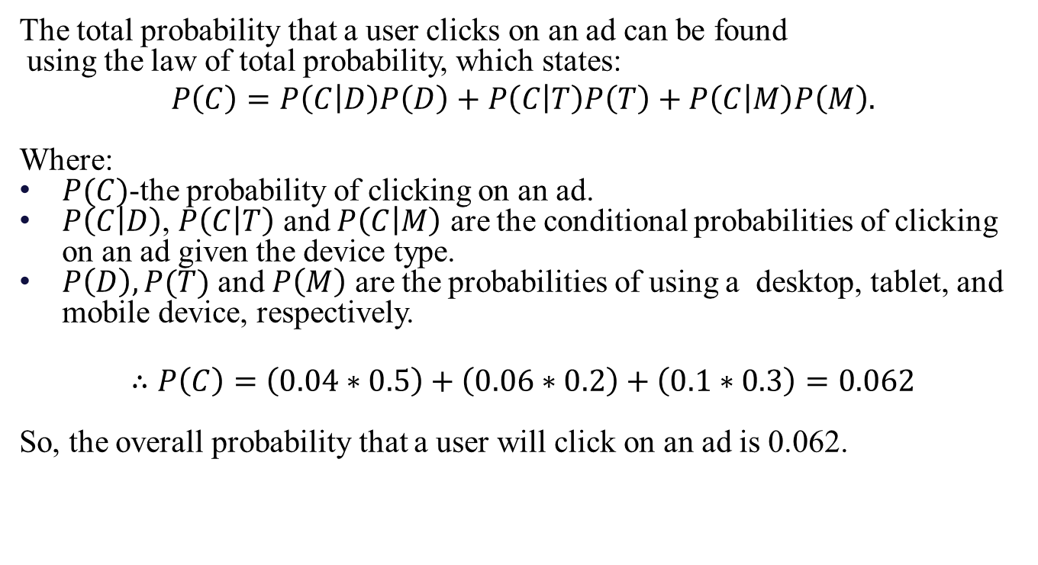
Solution

Slide 45
Example-4
Forest A occupies 50% of the total land in a certain park and 20% of the plants in this forest are poisonous. Forest B occupies 30% of the total land and 40% of the plants in it are poisonous. Forest C occupies the remaining 20% of the land and 70% of the plants in it are poisonous. If we randomly enter this park and pick a plant from the ground, what is the probability that it will be poisonous?

Slide 46
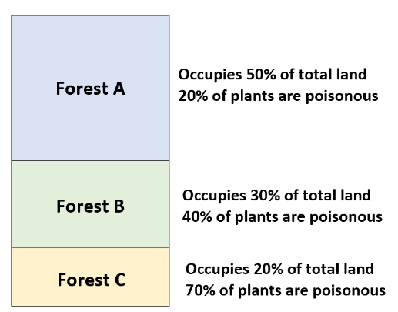
Given:

Slide 47
Solution
If we let P(P) = the probability of the plant being poisonous, and P(B_{i}) be the probability that we’ve entered one of the three forests, then we can compute the probability of a randomly chosen plant being poisonous as:
P(P) = ΣP(P|B_{i})*P(B_{i})
P(P) = P(P|B₁)*P(B₁) + P(P|B₂)*P(B₂) + P(P|B₃)*P(B₃)
P(P) = (0.20)*(0.50) + (0.40)*(0.30) + (0.70)*(0.20)
P(P) = 0.36

Slide 48
Example-5
A person has undertaken a mining job. The probabilities of completion of the job on time with and without rain are 0.42 and 0.90 respectively. If the probability that it will rain is 0.45, then determine the probability that the mining job will be completed on time.

Slide 49
Solution
Let A be the event that the mining job will be completed on time and B be the event that it rains. We have,
P(B) = 0.45,
P(no rain) = P(B′) = 1 − P(B) = 1 − 0.45 = 0.55
By multiplication law of probability,
P(A|B) = 0.42
P(A|B′) = 0.90

Slide 50
Solution
Since, events B and B′ form partitions of the sample space S,
by total probability theorem, we have
P(A) = P(B) P(A|B) + P(B′) P(A|B′)
=0.45 × 0.42 + 0.55 × 0.9
= 0.189 + 0.495 = 0.684
So, the probability that the job will be completed on time is
0.684.

Slide 51
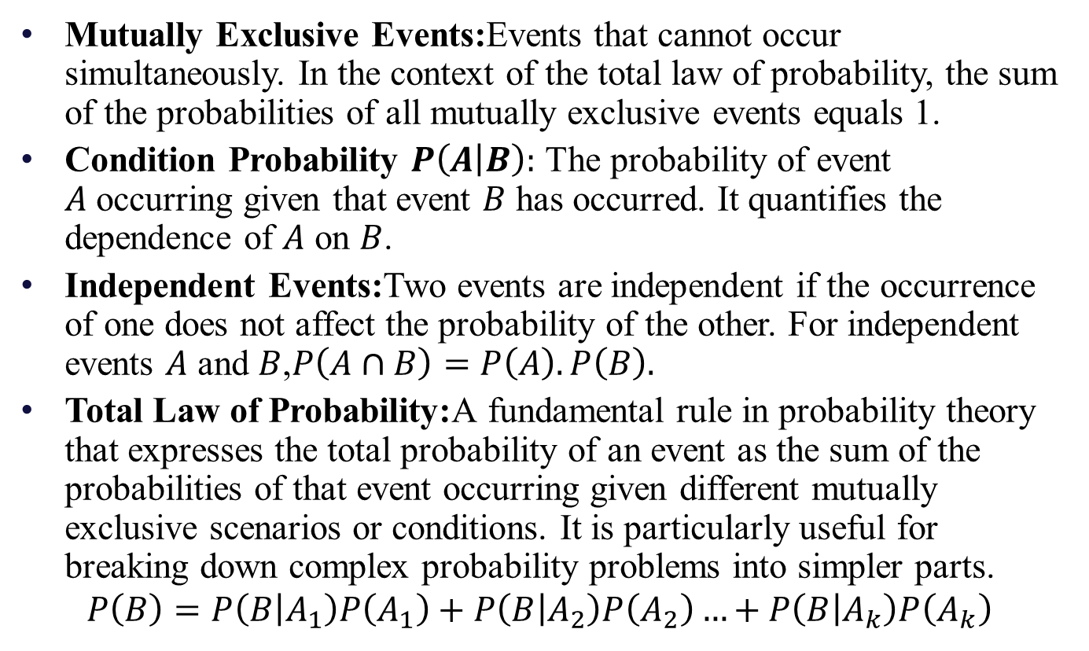
Glossary

Slide 52
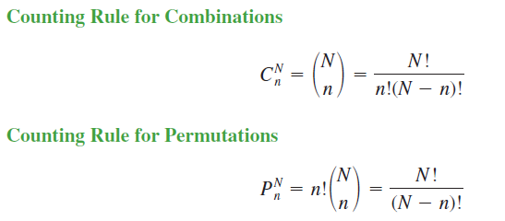
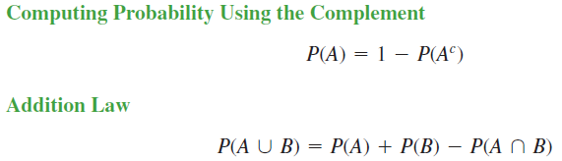
Important Formulae

Slide 53
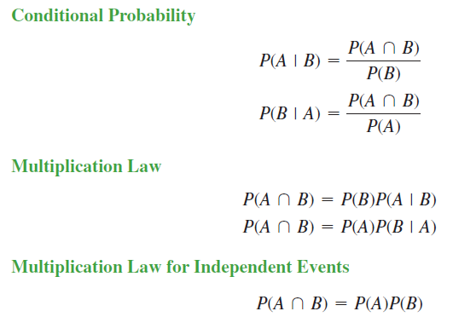
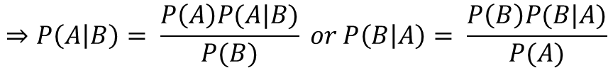
Important Formulae
$$∵P\left(B\right)P\left(B | A\right)=P\left(A\right)P\left(B | A\right)=P\left(A∩B\right)$$
$$⇒P\left(A | B\right)= \frac{P\left(A\right)P(A|B)}{P(B)} or P\left(B | A\right)= \frac{P\left(B\right)P(B|A)}{P(A)}$$

Slide 54
Practice Problems
Example 1.
An office has 4 secretaries handling respectively 20%, 60%,15% and 5% of the files of all government reports. The probability that they misfile such reports are respectively 0.05, 0.1, 0.1 and 0.05. Find the probability that the misfiled report can be blamed on the first secretary.
Ans: 0.1143
Example 2.
In a class 70% are boys and 30% are girls. 5% of boys and 3% of girls are irregular to the classes. What is the probability of a student selected at random is irregular to the classes and what is the probability that the irregular student is a girl?
Ans: P(Irregular Student) = 0.044, P( Irregular and Girl) = 0.009

Slide 55
Practice Problems
Example 3.
Three machines A, B and C produce respectively 60%, 30% and 10% of the total number of items of a factory. The percentage of defective outputs of these machines are 2%, 3% and 4%. An item is selected at random and is found to be defective.
(i) Find the probability that the item was not defective and produced by machine C?
Ans: 0.096
(ii) What is the probability that the item was produced by machine C or B? Ans: 0.4
Example: 4
A card is randomly drawn from an incomplete deck of cards from which the ace of diamonds is missing.
What is the probability that the card is “clubs”? ( Ans. 13/51)
What is the probability that the card is a “queen”? (Ans. 4/51)
Are the events “clubs” and “queen” independent (Ans. No)

Slide 56
Practice Problems
Example: 5
Three companies produce the same tool and supply it to the market. Company A produces 30% of the tools for the market and the remaining 70% of the tools are produced in companies B and C. 98% of the tools produced in company A, 95% of the tools produced in company B and 97% of the tools produced in company C are not defective. What percent of tools should be produced by companies B and C so that a tool picked at random in the market will have a probability of being non defective equal to 96%?
Ans: 0.164

Slide 57
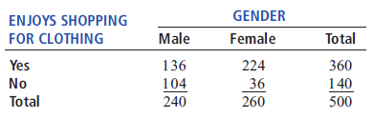
Practice Problems
Example: 6
A sample of 500 respondents was selected in a large metropolitan area to study consumer behavior, with the following results:
a. Suppose the respondent chosen is a female. What is the probability that she does not enjoy shopping for clothing? (Ans: 0.1384)
b. Suppose the respondent chosen enjoys shopping for clothing. What is the probability that the individual is a male?(Ans: 0.56)

Slide 58
Practice Problems
Example: 7
A standard deck of cards is being used to play a game. There are four suits (hearts, diamonds, clubs, and spades), each having 13 faces (ace, 2, 3, 4, 5, 6, 7, 8, 9, 10, jack, queen, and king), making a total of 52 cards. This complete deck is thoroughly mixed, and you will receive the first 2 cards from the deck without replacement.
a. What is the probability that both cards are queens? (Ans: 0.0045)
b. What is the probability that the first card is a 10 and the second card is a 5 or 6? (Ans: 0.012)
c. If you were sampling with replacement, what would be the answer in (a)? (Ans: 0.0059)

Slide 59

IMP Note to Self

Slide 60
Thank you

